Slide 1
Mundra SEZ & Industrial Zone, Gujarat
« One-Stop Solution for Investors »
1

Slide 2
Flagship
Infrastructure & Utility Core Portfolio
Energy & Utility Transport & Logistics
(60.5%) (73.9%) (66.0%) (100%)
Primary Industry
Emerging B2C
Incubator
Materials, Metal & Mining
Direct to consumer
(72.6%)
(63.2%)
AEL
AGEL
Renewables
ATL
T&D
APSEZ
Ports & Logistics
NQXT
Cement
(37.4%)
(75.0%)
(100%)
(44.0%)
ATGL
Gas Discom
APL
IPP
PVC
AWL
Food FMCG
(100%)
Copper, Aluminum
(100%)
(50%)
(100%)
(100%)
(100%)
(100%)
ANIL
New Industries
AdaniConneX⁴
Data Centre
AAHL
Airports
ARTL
Roads
Mining Services & Commercial Mining
ADL
Digital
(%): Promoter equity stake in Adani Portfolio companies (%): AEL equity stake in its subsidiaries
- Represents public traded listed verticals
A multi-decade story of high growth centered around infrastructure & utility core
NQXT: North Queensland Export Terminal | ATGL: Adani Total Gas Ltd, JV with Total Energies |Data center, JV with EdgeConnex, AEL: Adani Enterprises Limited; APSEZ: Adani Ports and Special Economic Zone Limited; ATL: Adani Transmission Limited; T&D: Transmission & Distribution; APL: Adani Power Limited; AGEL: Adani Green Energy Limited; AAHL: Adani Airport Holdings Limited; ARTL: Adani Roads Transport Limited; ANIL: Adani New Industries Limited; AWL: Adani Wilmar Limited; ADL: Adani Digital Limited; IPP: Independent Power Producer Cement business includes 63.15% stake in Ambuja Cement which in turn owns 50.05% in ACC Limited. Adani directly owns 6.64% stake in ACC Limited. Ambuja and ACC together have a capacity of 66 MTPA, which makes it the second largest cement manufacturer in India.

Slide 4
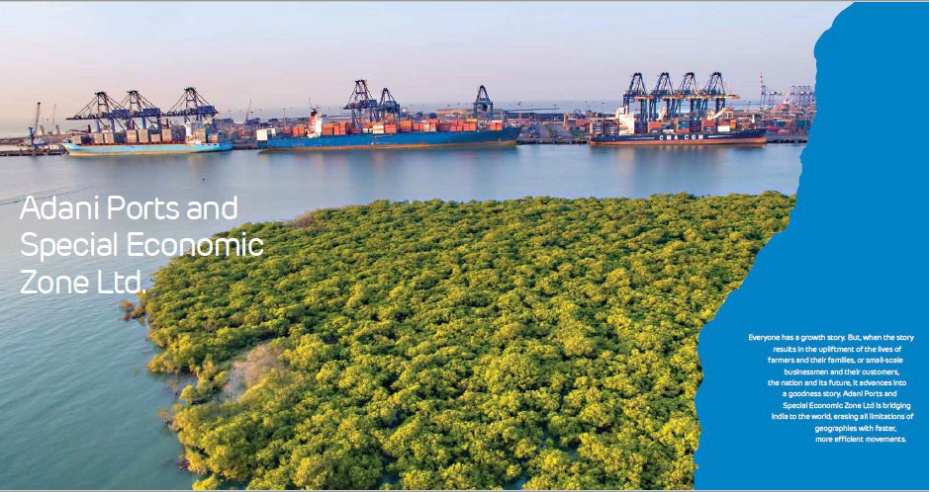
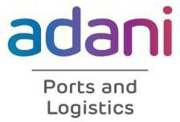

Slide 5
14
Ports and terminals in India
337MMT
Cargo handled in FY23
Dahej 16
MMT
Moga
Kanech
Kotkapura
Largest Port in India in Mundra
Largest Marine Services Provider in India
Kaithal
Kilaraipur
Tauru
Panipat
Tuna 14
MMT
Dhamora
113 No of Tugs
Patli & Loni
Palwal
Kannauj
Samastipur & Darbhanga
Kishangarh
Patna
28
No of dredgers
Mundra 264 MMT
Virochannagar
Vidisha | Harda Hoshangabad | Satna Ujjain | Dewas
Katihar
Indore
Kolkata
^Haldia 4 MMT
Largest Dredging Fleet in India
Largest Pvt. Container Train Operator in India
11
Logistics Parks
Tumb & Valvada
Nagpur
Dhamra 50 MMT
Hazira 30 MMT
Mumbai
Mundra -
India’s Largest
Port by
Volume
Taloja
113
Rakes
Dighi 8 MMT
Gangavaram 64 MMT
Container Terminals
Bulk Terminals
1.1MMT
Agri Silo capacity
Elavur
Krishnapatnam 75 MMT
Multipurpose Ports
Malur
Logistics Parks
Mormugao 5 MMT
Coimbatore
Kattupalli 25 MMT
Warehouse (Operational)
Largest Pvt. Bulk Train Operator in India
Largest Agri Silo Operator in India
2.4Mn Sft GradeA warehousing
Agri Silos
Warehouse (Under Construction)
^Vizhinjam
^{18 MMT}
Ennore 12 MMT
Karaikal 22 MMT
Silos (Under Construction)
Logistics Parks (Under Construction)
Grown from a single port to fourteen Ports ~607 MMT of capacity to handle all types of cargo.
^under construction

Slide 6
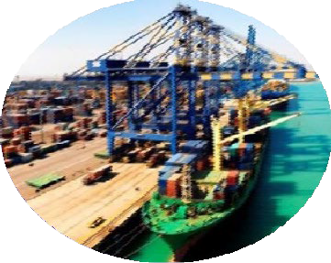
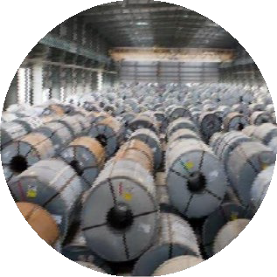
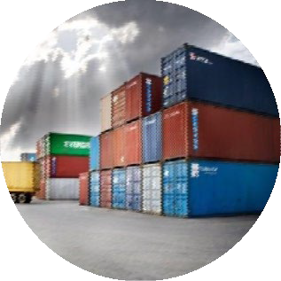
Logistics
Ports
Total installed capacity of 560 mmtpa
Concession assets with free pricing
SEZ (at Mundra)
Land bank of over 8,481 hectares
Integration with port, developing industry cluster
20 year license to operate rails
Enhancing connectivity between
ports and origin / destination of cargo
Infrastructure
Handling
Marine
Quay
Storage
Logistics
20 dredgers 24 tugs | 14+ KM length 47 berths 18 terminals | 50 Bulk handling cranes 145 RTGs⁽¹⁾ 24 stakers and reclaimers 101 KM conveyors | 4.2 MN sq. mtrs. bulk storage area 0.9 MN KL tankages 51,385 container ground slots | 8 Logistics Parks 77 rakes, 140+ trucks 9 MMLPs 11.4 LMT silos 0.8 Mn Sft warehouse
Delivering synergistic value through its integrated model across ports, logistics and SEZ business lines
Note: Rubber Tired Gantry crane
6

Slide 7
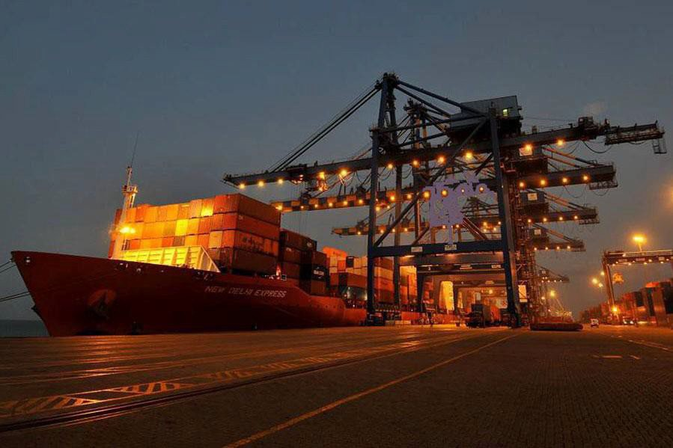
Mundra Port Overview

Slide 8
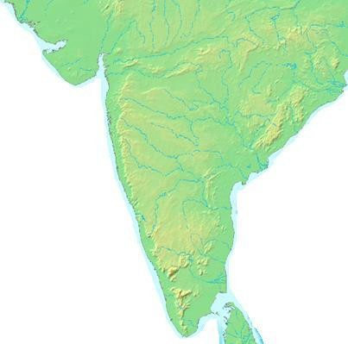
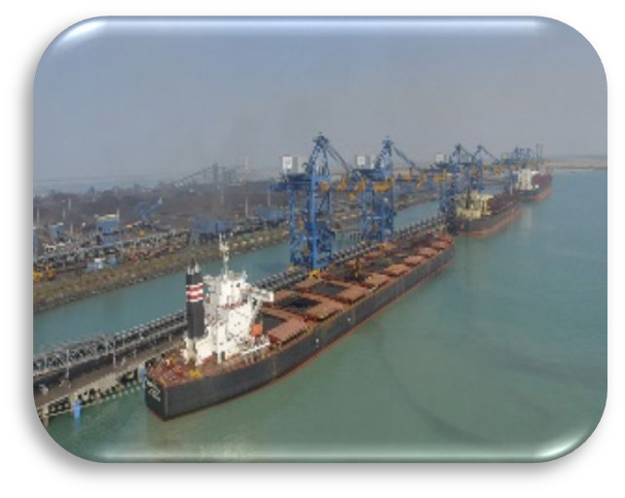
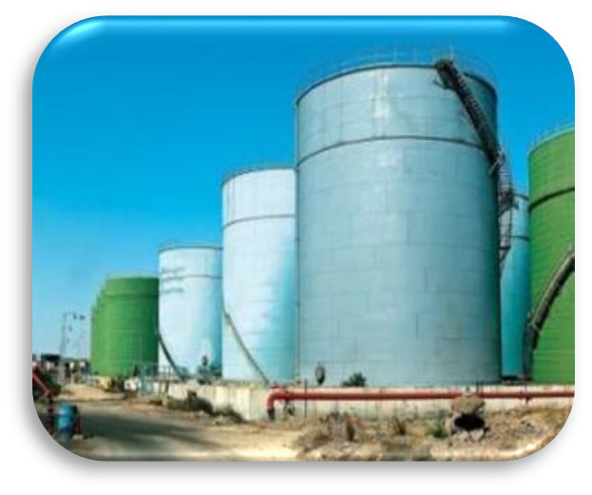
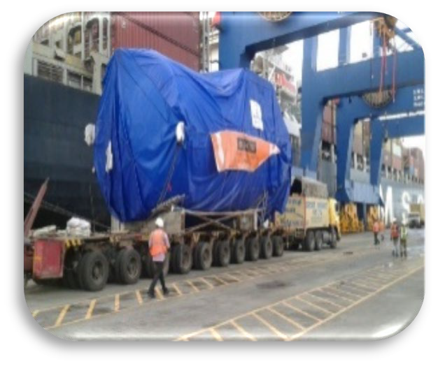
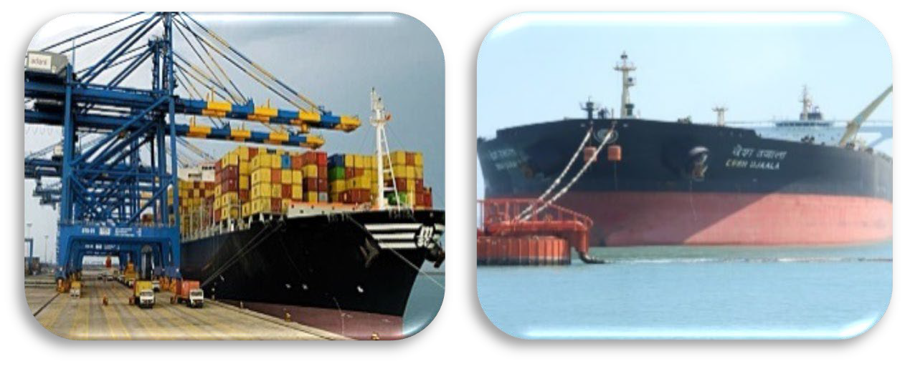
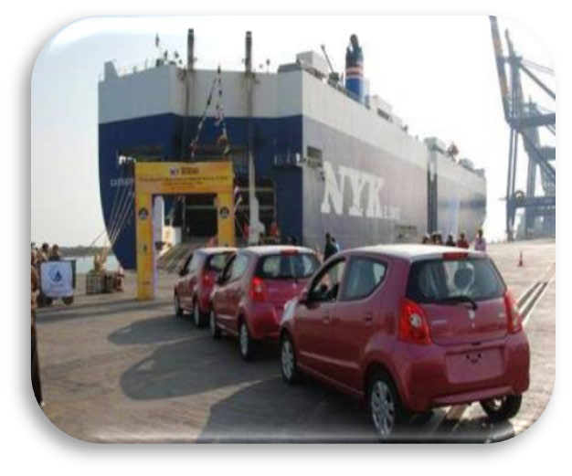
Mundra port has dedicated and specialized infrastructure for handling all types of cargo
Mundra Port
Bulk & Break Bulk
Coal
Liquid, LNG, LPG
OD Cargo
Mundra Port (capacity of 264 MMT) with 27 berths and 2 SPM equipped to handle bulk, break-bulk, bulk liquid, LNG, LPG containers, Ro-Ro and Over-dimensional project cargo
Large land backup for development and 40 kms of waterfront
Container
SPM
Warehousing
Ro-Ro
Warehousing

Slide 9
Mundra Port is the largest private port in India
Mundra Port 249 315 India | Mundra Port is India’s largest private port. In FY 23, Mundra Port handled over 155 Mn MT cargo. Dry Cargo – 38 Mn MT (Coal 35 MMT) Liquid Cargo – 24.69MMT Container Cargo – 99.32 MMT Strategically located in the Gulf of Kutch, APSEZ is a natural gateway to the cargo hubs in In d i a ’ s n orthern and w estern h interland. Certifications: ISO 9001:2008, ISO 14001:2004, OHSAS 18001:2007, ISO 28001:2007, NSPC and ISPS Mundra SEZ is first port-based multi-product SEZ Deep draft up to 18 Mtr. which allows large vessels like Panamax & Super Post Panamax to berth Mundra Port handled the largest container ship ever handled at any port in India.
Cargo Growth (Mn MT)
₁₁₁ ₁₁₄ ₁₂₂ ₁₃₉ 144 150 ₁₀₁ 109 82 FY 14 FY 15 FY 16 FY 17 FY 18 FY 19 FY 20 FY 21 FY 22

Slide 10
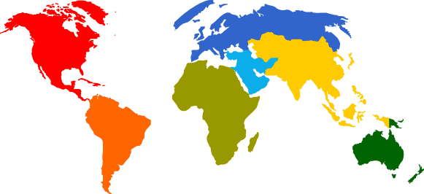
Mediterranean
Largest and only port in India that can handle 18000 TEU vessels
North Europe Rotterdam Felxistowe London Gateway Antwerp Bremerhaven Wilhelmshaven
_{US East Coast} Southampton
Haifa Mersin Ashdod
Damietta Port Said Barcelona
87 weekly sailings to over 100 ports across the world
Alexandria Fos Sur Mer
Piraeus Tangier Cagliari
Genova La Spezia Livorna
Only Port in India to have JV with leading lines MSC & CMA CGM
Far East / S.E Asia
Port Kelang Xiamen Shanghai Ningbo Dachan Bay Shekou Singapore Hong Kong Laem Chabang Xinggang Busan
Chiwan Nansha
New York Norfolk Savannah Charleston Miami
Hamburg Dunkirk Le Havre
Red Sea Jeddah Aqaba Djibouti Aden
Port Sudan King Abdullah
Middle East / Gulf
Khor Fakkan Jebel Ali Bandar Abbas Salalah
Port Khalifa Sohar Sharjah Dhammam Jubail
Caribbean
Freeport
West Africa Luanda Lagos-Apapa Lagos-Tincan Cotonou Point Noire Apapa Tincan Contonou Lome
Indian Sub Continent Karachi Colombo Chittagong Cochin Tuticorin Mangalore Hazira Kattupalli Goa Kandla Pipavav
East Africa Port Louis Mombasa Galets Tamatave Port Victoria Port de Poine des
South Africa
Durban Port Elizabeth Ngquara Cape Town Walwis Bay
Sailings | Indian Coastal | Gulf | ISC | Far East | North Europe | Med | East Africa | West Africa | South Africa | Red Sea | USEC | Caribbean
Weekly Sailings | 6 | 25 | 15 | 5 | 5 | 9 | 4 | 2 | 3 | 9 | 3 | 1

Slide 12
Mundra SEZ & Industrial Zone Overview

Slide 13
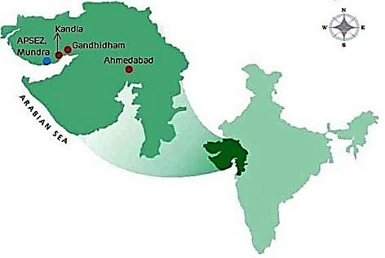
Port and Industrial Town
Nearby Cities
Population of Kutch Region- 2.5 Million
Population of Gandhidham- ~ 0.4 Million
Population of Mundra - ~ 150,000 (10,000 in 2001)
Gandhidham- 55 Kms
Bhuj- 60 Km
Rajkot- 250 Kms
Ahmedabad- 350 Kms
Multi Modal Connectivity
Road
Air
NH8 A Ext. connects Mundra to NH8 (Delhi- Mumbai).
Additionally connected through NH-15.
SH – 6: Mundra to Gandhidham
SH – 48: Mundra to Bhuj
Nearest domestic commercial airports are located at Bhuj (~60 kms) & Kandla (~50 kms)
Nearest international airport and air cargo terminal is at
Ahmedabad ( 350 kms)
Mundra Airport is a licensed airport in ‘Private Use Category’ (Environmental Clearance for Commercial airport is received)
Rail
Nearest railway stations for passengers are at Gandhidham and Bhuj
Total Land Special Economic Zone
15000 Hectares 8300 Hectares
Free Trade & Warehousing Zone
Domestic Tariff Area
140 Hectares
6500 Hectares

Slide 14
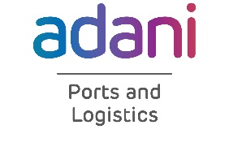
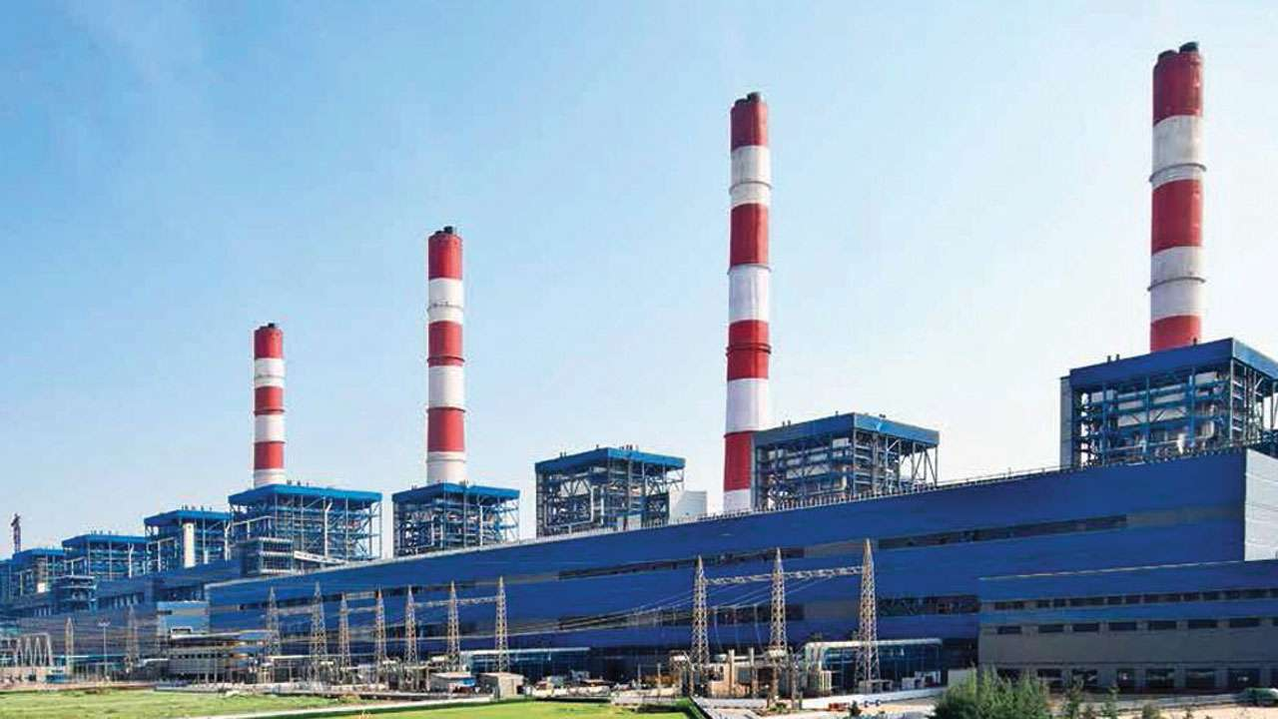
Master plan of Mundra Industrial Park
National Highway 8A
Mundra Town
Railway Station
State Highway SH 6
Airport
Railway Line
Network
SEZ Main Gate
CETP
Power Station
WTP
Adani Power Plant
Hotel
Hospital
Township
EMC Cluster
CFS
Central
Business
Unit
Coal Yard
Port Main Gate
West Port
Ro Ro Terminal
Dry Storage
Steel Yard
Coal Terminals
Liquid Tanks
LNG Terminal
Container Terminals
Dry / Bulk Terminal
LPG Terminal
South Port
Liquid Terminal (2 SBM)

Slide 15
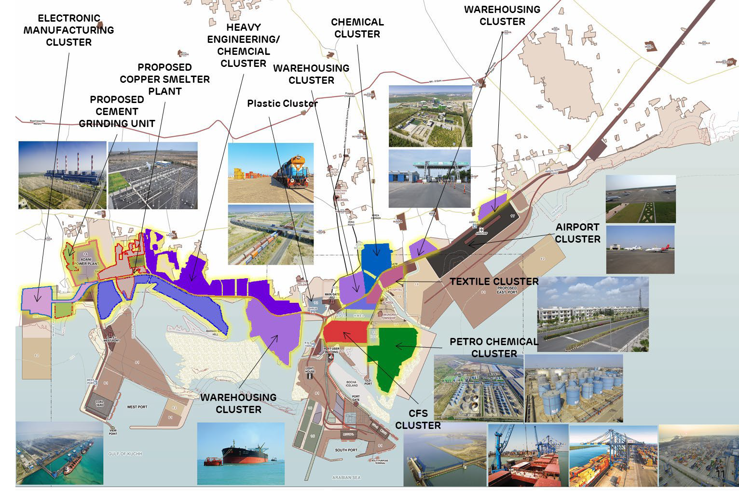

Slide 16
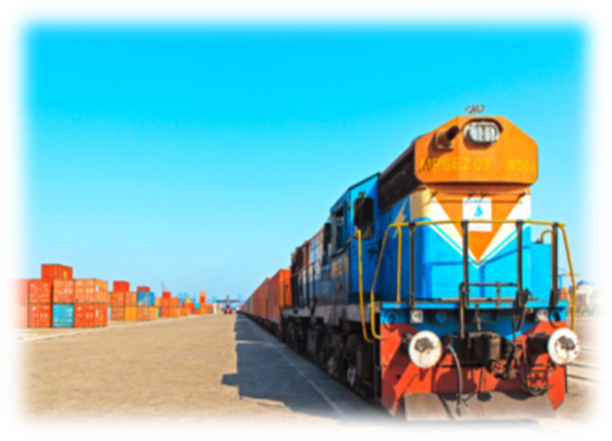
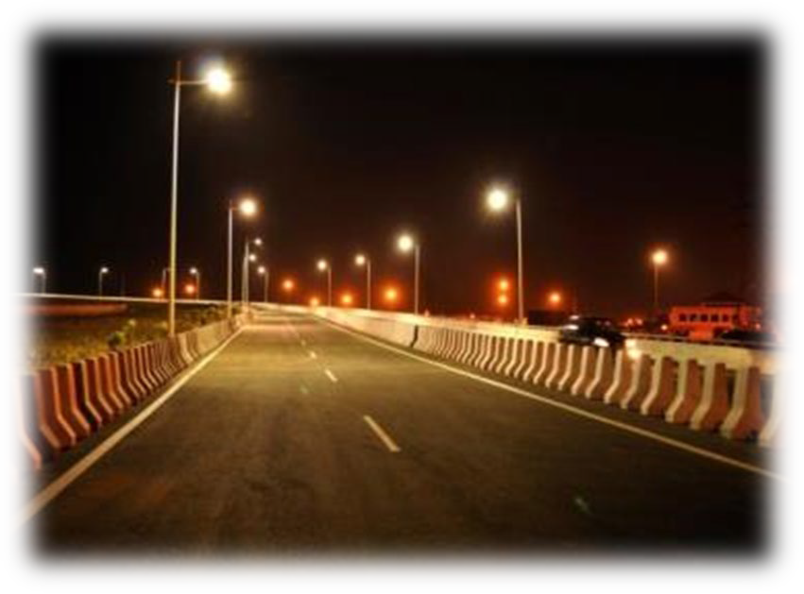
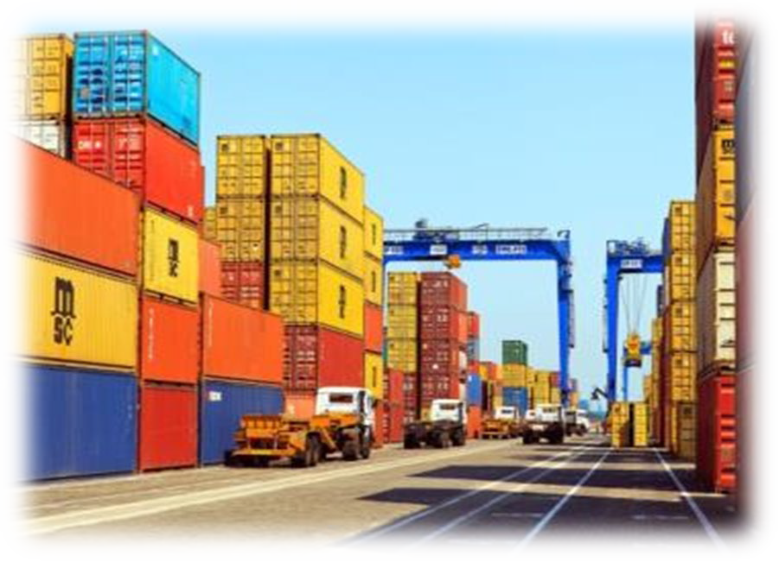
RAIL
AIR
ROAD
PORT
Mundra Airstrip is a licensed airport in ‘Private Use’
Present runway strip is 2,200 m, which will be expanded to 4,000 m.
Existing Rail Network of 210 km (including Mundra – Adipur line)
Elaborate planned seamless
Road Network to provide
12 Multi Purpose Berths
9 Container Berths
2 SBM for import of crude oil
4 Berths for import of coal
Ro-Ro facilities for
connectivity
Time and cost
saving by
of distance
for Northern
across APSEZ zone.
120 km arterial and sub- arterial roads had been constructed & additional 30 Km to be added soon.
virtue advantage hinterland
1,000 Ha
earmarked for Logistic Hub,
developing
automobile cargo
Mundra is connected to all global major consumption and industrial centres through shipping lines such as Maersk, MSC, CMA CGA etc.
MRO & Terminal Buildings.
Regional air connectivity is
7 Locomotives owned by APSEZL
National Highway 8A Extension, State Highway
48 & State Highway 6 provide excellent external connectivity for APSEZ
operational between
Mumbai – Bhuj & Kandla (Air India & Spice Jet)

Slide 17
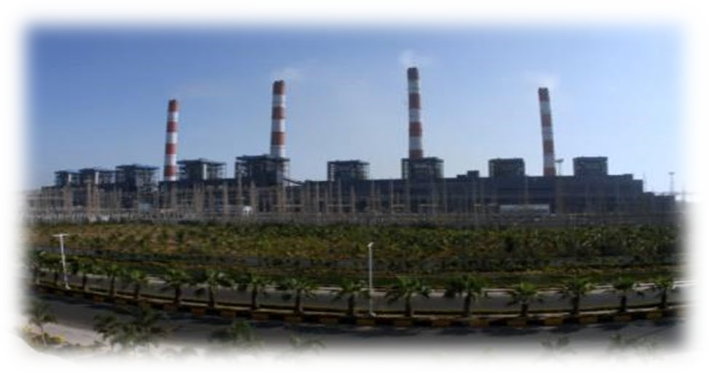
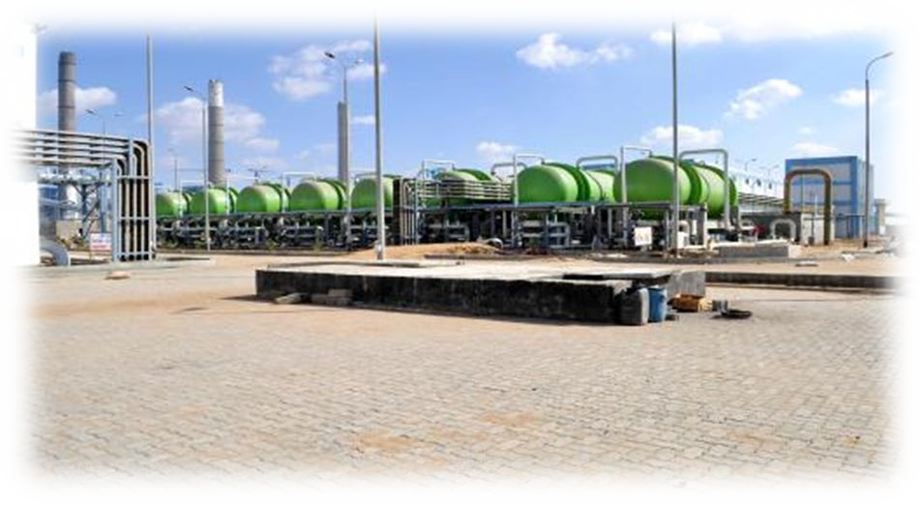
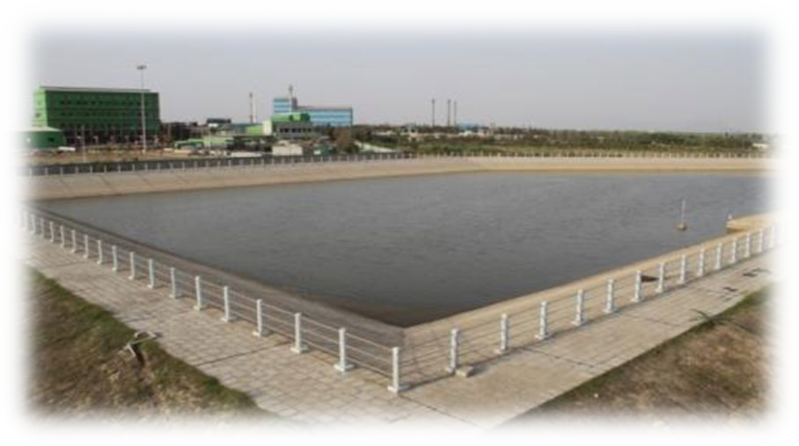
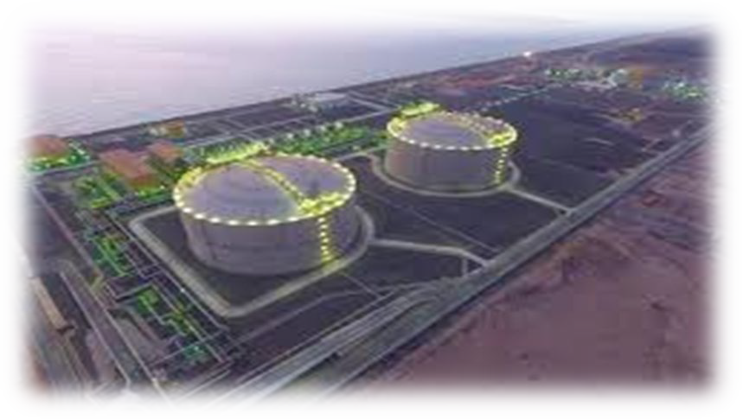
POWER Generation & Distribution
One of the cheapest power in Gujarat
WTP (Water Treatment Plant)
200 MLD water desalination plant planned
47 MLD desalination plant operational
60 Kms of water supply line is developed.
CETP (Common Effluent Treatment Plant)
LNG & LPG AVAILABILITY
5 million MT LNG Terminal got operational in 2019
1.34 million MT LPG Terminal got operational in 2020
Environment Clearance received for CETPs (54 MLD & 17 MLD)
4620 MW Power Plant within SEZ commissioned by Adani Power, & 4000 MW - UMPP by Tata Power
2.5 MLD CETP is operational in first phase
24 X 7 Reliable power is offered at competitive rates by the distribution licensee within SEZ.
Exemption on payment of electricity duty for 10 years within SEZ
Power supplied at 220 Kv / 66 Kv / 33 Kv / 11 Kv

Slide 18
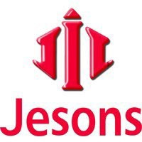
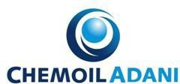
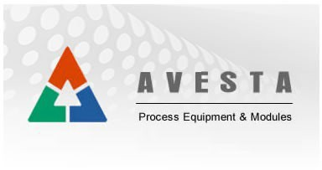
CRUDE & PETROLEUM
CHEMICALS
TEXTILES
FOOD PROCESSING
ENGINEERING
ELECTRONICS
LOGISTICS & WAREHOUSING

Slide 19
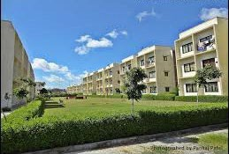
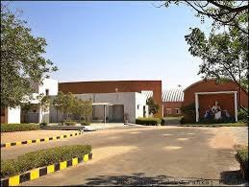
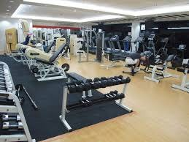
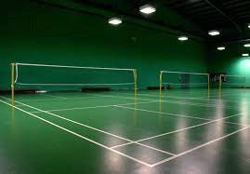
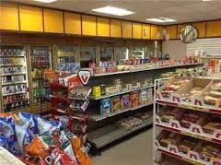
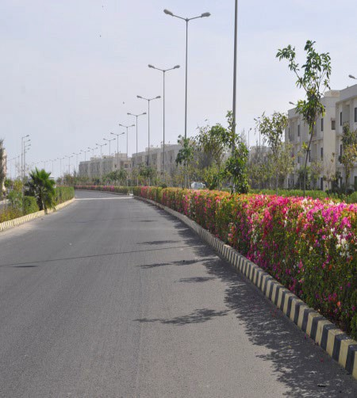
255 Ha Gated Adani Residential Township with 6400 Apartment Units and Villas
Modern Health Centre with Gym, Indoor Game like Badminton, Table Tennis, Snooker etc.
Convenience Stores, Open Air Theaters, Jogging and Cycling paths make for an excellent living
Well planned development of the township in 255 acres
Adani DAV & Calorx Public School
Recreational club incl. multiplex, sport complex, resorts, restaurants, 100 bed multi-speciality hospital
Customised township can be built as per the requirement for expat living.
19

Slide 20
Fiscal Beneﬁts
Operational Beneﬁts
No routine examination by Customs of export and import cargo. Cargo clearance by self-certiﬁcation SEZ Rule 46(c), 26(10) & 75
On procurement of Capital Goods & Raw Chapter VI Section 26, SEZ Act
Materials & Services
Beneﬁts from Central Government
Selling of SEZ units allowed in DTA, upon payment of applicable duty. Chapter VI, Section 30 SEZ Act & SEZ Rule 47
Exemption from Duty of Customs
Exemption from GST
Drawback on goods brought or services DTA to SEZ Unit
provided from
DTA suppliers to units can avail export incentives SEZ Rule 23
Relaxed Labour Law for SEZ units in Gujarat As per Industrial disputes, Gujarat – Amendment, 2004
Sub-contracting permissible SEZ Rule 41
Single window clearance for statutory requirements. Chapter IV, Section 13 SEZ Act
Supplies from DTA to SEZ shall be eligible for export beneﬁts
SEZ Rule 23
Beneﬁts from State Government
Exemption from Stamp Duty and registration fees on lease of land/mortgaged deed.
Exemption from Electricity Duty for 10 years from date of operation
Tax Exemption
Exemption from Capital Gain Tax arising on transfer of assets from urban area to SEZ (Section 54-GA of Income Tax Act) Single Window Clearance Chapter IV, Section 13 SEZ Act
Other Beneﬁts
Cost competitive ﬁnancing can be availed from Offshore Banking Units (OBUs)
External commercial borrowings upto US $500 million can be availed without any speciﬁc approvals
100% FDI permitted through an automatic approval route. No limit on the quantum of DTA sales

Slide 21
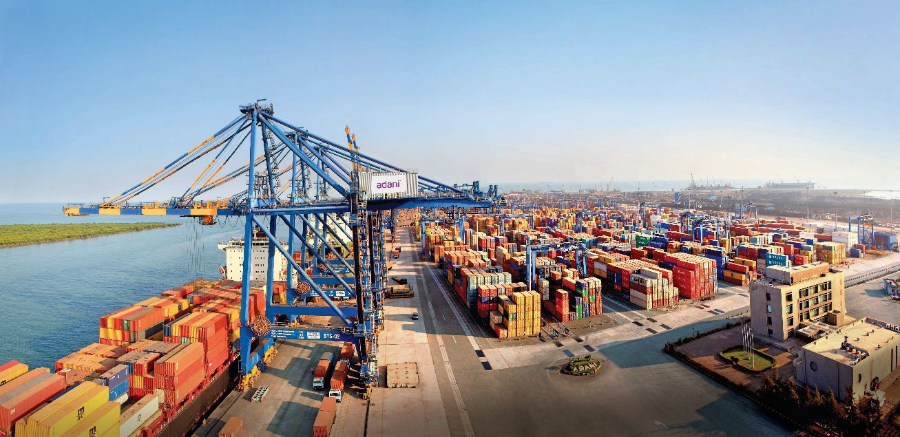
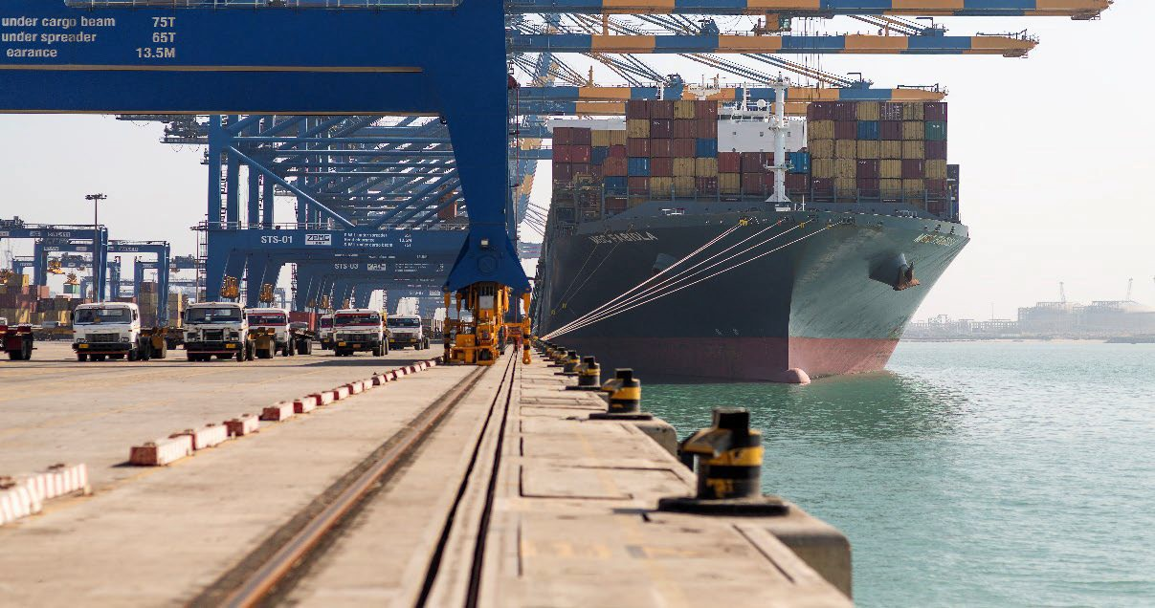
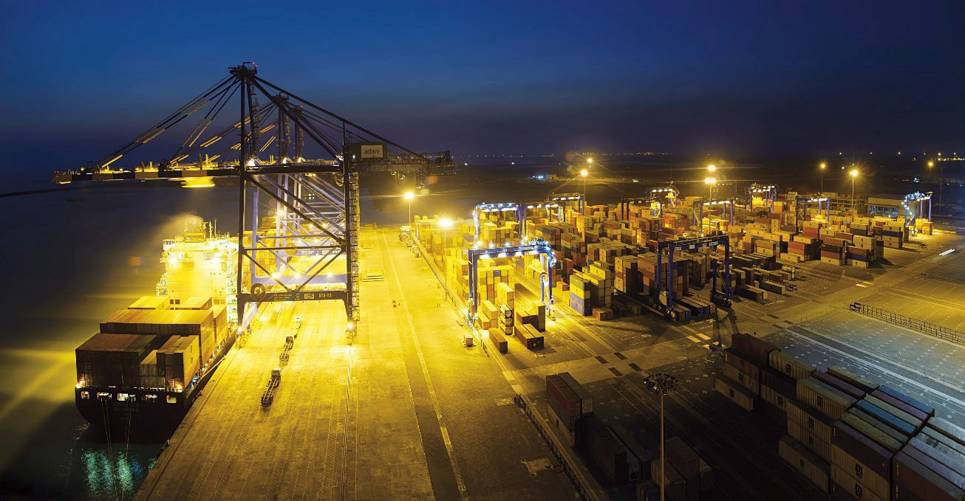
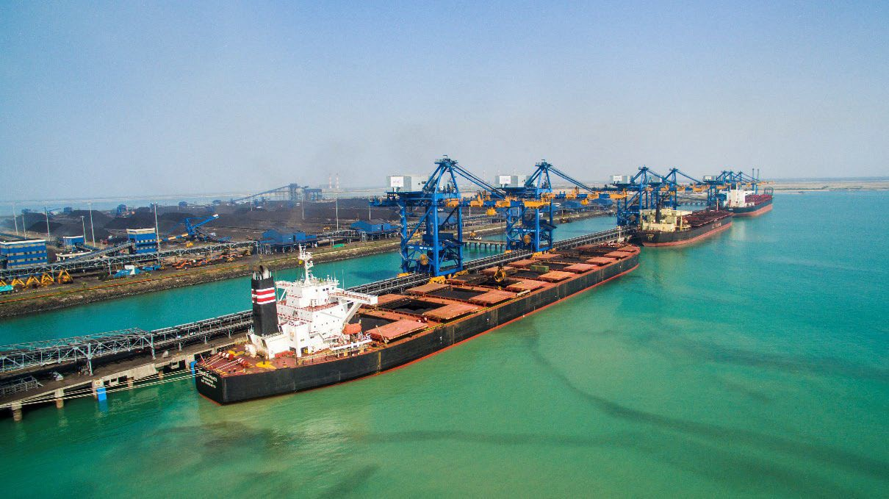

Slide 22
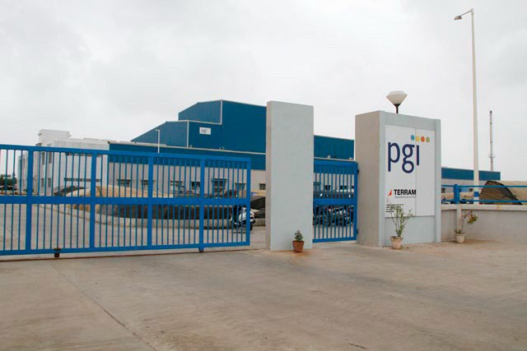
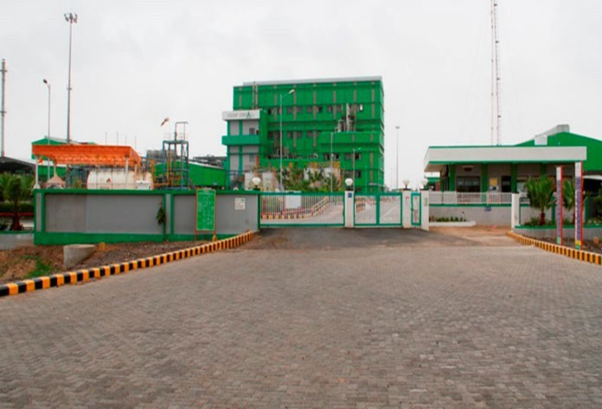
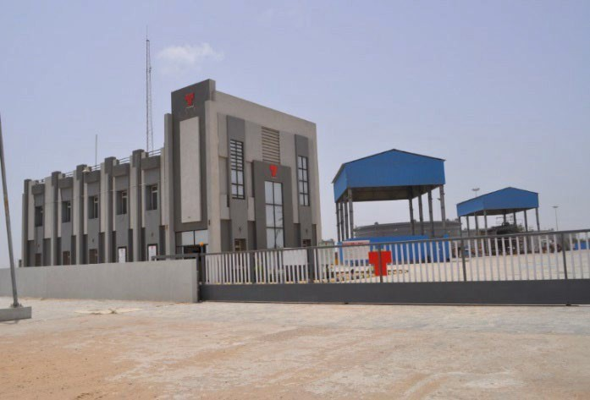
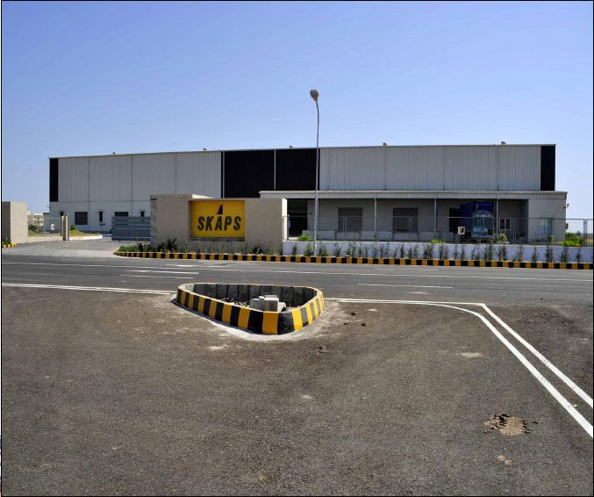
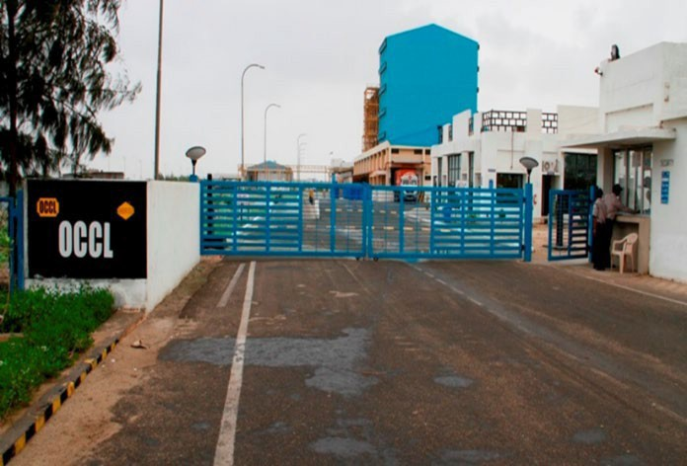
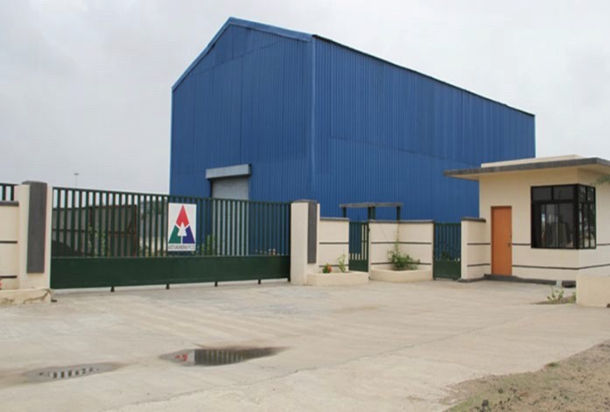
Chemical Units
MITAP: Textile Units
Engineering Units
22

Slide 23
Integrated infrastructure increases operational efficiency of the unit cascading into OPEX saving.
Customised Township can be developed in the social infrastructure of the zone providing high standard living, learning and recreation for its employees.
Mundra Industrial Hub can potentially reduce inventory carrying cost (Raw material & finished goods)
CAPEX for Backup power or DG sets not required in the zone with 24 x 7 uninterrupted power supply.
In zone CBD comprises of Development Commissioner’s office, Customs, Banks, other government offices, CHA’s, etc., reducing the need for additional manpower.
Zone’s Security infra reduces the burden on the individual units in the zone as it becomes part of a highly secured area.
LNG/ LPG is available in the zone - an advantage to manufacturing units.
Zone provides 24 X 7 fire protection services to units. Fire safety team in the zone have the preparedness to counter any emergency.

Slide 24
Large continuous land parcels available for industrial development in proximity to the port infrastructure
Ancillary units can be accommodated in a cluster near the large unit
Mundra port and industrial i nfrastructure with its operational excellence can be
leveraged for efficient exports/ imports
Seamless connectivity to hinterland through road and rail
Quality and reliable supply of utilities i.e. power, water, CETP
End to end logistic solutions from the zone can be provided for operational ease
Flexibility on commercials can be provided by the developer for large project

Slide 25
Robust ESG Assurance Framework
Guiding principles
United Nations Global Compact
Sustainable Development Goals
GRI Standards
Policies
Guiding principle
Policy Structure
Focus Area - UNSDG
− Climate Action
− No poverty
− Zero hunger
− Good health and well being
− Quality education
− Clean water and sanitization
− Affordable and clean energy
− Decent work and economic growth
− Industry, innovation & infrastructure
ESG
E
− Environment Policy covered in Business Responsibility (BR) Policy
− Human Rights covered in BR Policies
S − Corporate Social Responsibility Policy
− Occupational Health and Safety Policy
Focus Areas
Assurance
− Board Diversity
− Dividend Distribution and Shareholder Return Policy
− Related Party Transaction Policy
G
Policy framework backed by robust assurance program
UNSDG: United Nations Sustainable Development Goals

Slide 26
Environmental Philosophy
Offsetting Carbon Emission
Conservation of Resource
Waste Management
− Carbon sequestration by afforestation
− Improving Carbon Efficiency
− Reducing water footprint
− Land use and cover management
− Energy Management
− Optimizing Input Consumption
− Recycling waste through land-filing
− Circular Economy
− Scientific Disposal of Hazardous Waste
Climate Awareness
− Promote green energy through low- cost manufacturing platforms
− Afforestation and Conservation
− Faster reclamation of de-coaled areas
− Reduce freshwater withdrawal
− Reuse, recycle and replenish
− Water neutrality
− Optimize Land use
− Biogas Plant (Waste to energy) – Installed in solar manufacturing for treatment of 100% food waste
− Reduce waste outcome
Climate Readiness
Business and future investment aligned to sustainable growth with focus on preserving environment
− Water Neutrality
− Research & Development and Innovation for green technology.
− Biodiversity Management & Conservation.
− Innovative Reforestation technology of Tree Transplantation to conserve local ecology.
− Conceptualization of in-house recycling plants
Climate Alignment
CDP: Carbon Disclosure Project; TCFD: Task Force on Climate related Financial Disclosure; SBTi: Science Based Target initiative

Slide 27
Social philosophy
AEL’s Key Social Initiatives mapped to UNSDG
United Nations Sustainable Development Goals 2030
Women’s Education
No Poverty
Zero Hunger
4. Quality Education
Multiple Locations
− Own schools, digitalization and up gradation of Govt. school to provide cost free education to the needy.
− Project Suposhan undertaken by Adani Wilmar is successfully continuing its operation
Women’s Health
3. Good Health & Well Being
Sarguja
− Partnered with self help group to educate and provide sanitary pads for safe menstrual hygiene to ensure better health.
Women’s Empowerment
2. Zero Hunger
5. Gender Equality
8. Decent Work & Economic Growth
Sarguja & Tamnar
− Various projects undertaken by Gauri Self help groups for collection and marketing of Non-Timber Forest Produce
Ecology
7. Affordable and Clean Energy
Climate Action
Life Below Water
Life on Land
Mundra
− Conservation of mangroves in coordination with GUIDE
Local & Rural infra Development
9. Industry, Innovation & Infra Structure
11. Sustainable Cities & Communities
Sarguja
− Organic Farming and Integrated Multi purpose business model
Water Secure Nation
6. Clean Water and Sanitation
Multiple Locations
− Deepening of ponds and tanks, Rooftop Rainwater Harvesting, Recharging Bore wells
Social philosophy drives initiatives that are aligned with UN Sustainable Development Goals
UNSDG: United Nations Sustainable Development Goals
27

Slide 28
27

